Slide 1
Machine Learning
Yevgeniy Vorobeychik
Machine Learning
CS 4269/6362

Slide 2
Today’s Topics
Course Overview
Goals
Policies
The Field of Machine Learning
What is it?
Foundations

Slide 3
Course Goals
Read and understand current research
Implement machine learning algorithms
Evaluate machine learning for applications

Slide 4
Course Policies
Requirements
Programming: homeworks will involve significant Java programming
Math: modern machine learning is rather math-heavy
Homeworks
Goals: learn to understand the ML algorithms, and learn how to implement them in practice
Late Policy:
1-day late is 50% off; 2+ days late is 0 credit
You get 2 late “Freebies” for the course where you can submit a homework up to 1 week late with no penalty
Final project: CS 4269: team project (2 per team); CS 6362: individual project
Either a research project, or an implementation of a practical machine learning system
Textbook: Bishop “Pattern Recognition and Machine Learning” (required; at BN; I may at times use material from other books as well, but this is the primary source of content for the course)
Grading: homework, presentation (for CS 6362 students only), project; class participation (10% of the grade!)
Cheating: homeworks are individual assignments; sharing any solutions is considered to be violations of the honor code

Slide 5
Course website
Blackboard: CS 4269 Projects in AI/Machine Learning
Everyone should have access to this (let me know if you encounter any issues)

Slide 6
CS 4269 Project Teams
By Friday 11:59pm, submit on blackboard an ordered list of up to 5 people from CS 4269 you wish to partner with
The rest will be randomly ordered
We will algorithmically select your team, using everyone’s submitted preferences

Slide 7
Course Overview
Math review
Linear algebra, calculus, optimization
Supervised Learning: linear and non-linear
Unsupervised Learning
Graphical Models
Reinforcement Learning (as time allows)

Slide 8
Machine Learning Foundations

Slide 9
What is ML all about?
Machine learning allows us to derive patterns from data which are not readily observable to human eye
Patterns can come in different forms; hence, different learning models and paradigms
Data
What type of input do we have? What input do we expect to know in the future?
What do we care about predicting or understanding?
Patterns: how are inputs/outputs related? How are input variables related to each other?
Notes:
Different algorithms balanced in different ways

Slide 10
A Diverse Topic
AI, Statistics, Linear algebra, Information Theory, Probability, Decision Theory
Fields
Applications
Vision, Robotics, NLP, Computational Biology, Bioinformatics, Speech, IR, Systems

Slide 11


Machine Learning in 3 Parts
Input
Algorithm
Output
Learning settings
Representations
What is learning?
How do we learn?
Evaluation

Slide 12
Input
Learning Settings
Representations

Slide 13
Learning Settings
What information is available for learning?
What does the data look like?
How is it annotated?
What output is desired?
What should the algorithm produce?
How will it be used?

Slide 14
Supervised Learning
Learning with a teacher
Explicit feedback in the form of labeled examples
Goal: make prediction
Pros: Good performance
Cons: Labeled data is difficult to find
“Classical” (labeled data simply there; do your best)
Query-based (can ask for labeled examples)
Examples
Classification
Is an email spam or not?
Regression
What is the expected rate of return on a specific investment?

Slide 15
Unsupervised Learning
Learning without labels
Only observed unlabeled examples
Goal: uncover structure in data
Pros: Easy to find lots of data
Cons: what are we looking for?
Examples
Clustering
Group emails by topic
Manifold learning
Find a low dimensional data representation

Slide 16
Semi-Supervised Learning
Labeled examples + unlabeled examples
Lots of ways to do this
Use unlabeled to guide learning in classification
Estimate input distribution; target learning/accuracy towards this distribution
Use unlabeled data to construct “meta-features”
Deep learning

Slide 17
Reinforcement Learning
Learn a behavior policy by interacting with the world
How to navigate in a world
Success measured by rewards received for actions taken
Maximize sum of rewards
Examples
Chess (and checkers)
Robot control
Piloting an airplane
Notes:
We won’t cover this

Slide 18
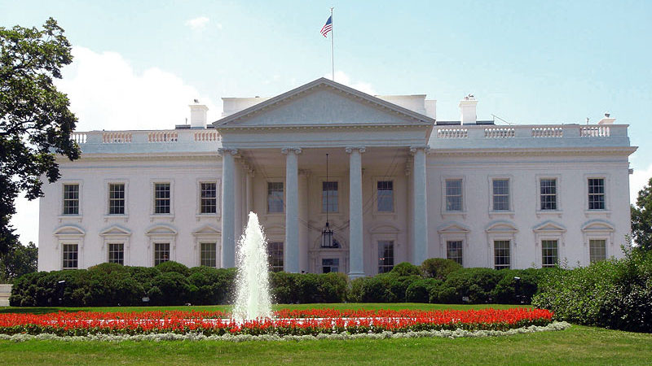

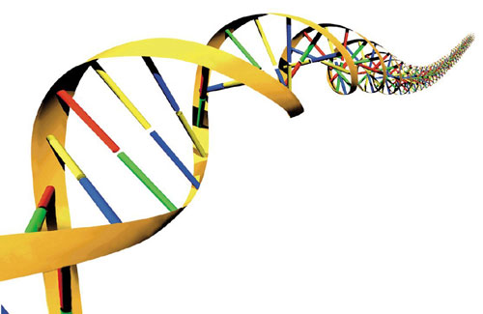
How Do We Represent Data?
Data is complex
How does a learning algorithm “see” data?

Slide 19
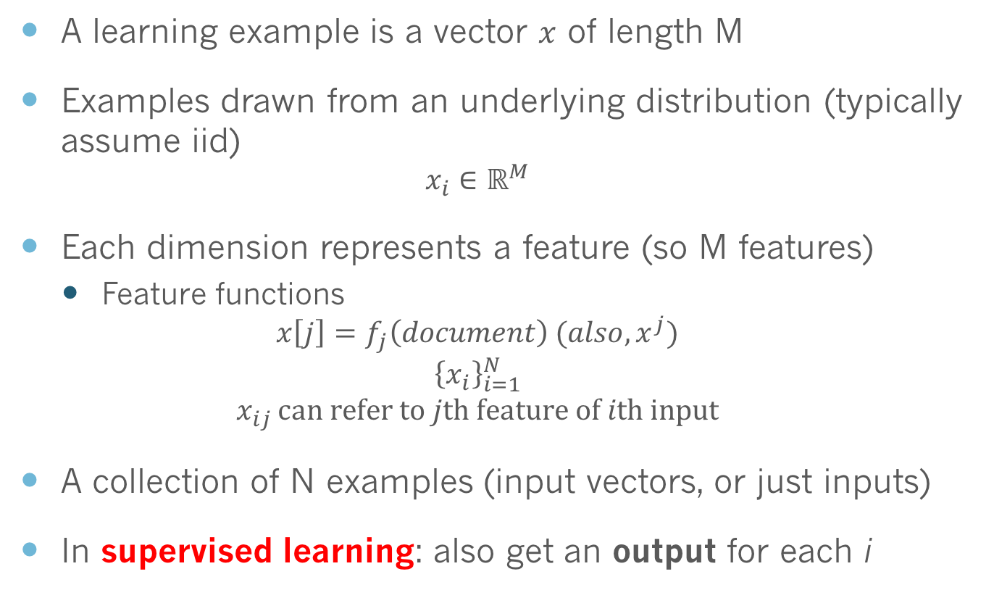
High Dimensional Vectors
A learning example is a vector $x$ of length M
Examples drawn from an underlying distribution (typically assume iid)
$$x_{i}∈ℝ^{M}$$
Each dimension represents a feature (so M features)
Feature functions
$$x\left[j\right]=f_{j}\left(document\right) (also, x^{j})$$
$${\left\{x_{i}\right\}}_{i=1}^{N}$$
$$x_{ij }can refer to jth feature of ith input$$
A collection of N examples (input vectors, or just inputs)
In supervised learning: also get an output for each i

Slide 20
What Does Data Look Like?
Predict airplane delay
Label | Bad weather | Other planes delayed | Ontime performance of route
Yes | Yes | 5 | 60%
No | Yes | 0 | 95%
Yes | No | 2 | 70%
No | No | 1 | 80%
Categorical/binary feature
Continuous feature
Notes:
Features of different types: categorical (binary), continuous

Slide 21
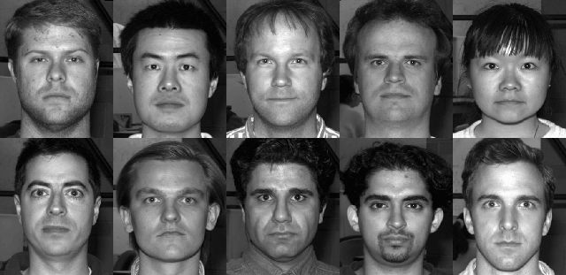
What Does Data Look Like?
Face recognition Input: faces Predict: does picture have face?

Slide 22
Representations
Designing feature functions is critical
Well designed representations greatly affect performance
Arguably, feature design is the most important thing in learning (more important than the algorithm)!
How should we design features?
Features are application specific
You need to know about biology/vision/speech/etc.
Since this is domain specific we won’t talk much about it

Slide 23
Algorithm
What is learning?
How do we learn?

Slide 24
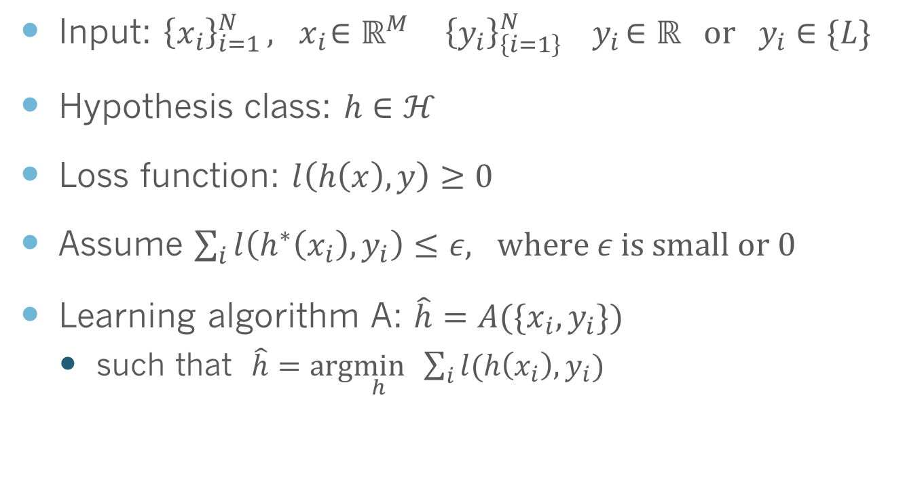
What Does it Mean to Learn? Supervised Setting
Input: ${\left\{x_{i}\right\}}_{i=1 }^{N}, { x}_{i}∈ℝ^{M} { \left\{y_{i}\right\}}_{\left\{i=1\right\}}^{N} { y}_{i}∈ℝ or { y}_{i}∈\{L\}$
Hypothesis class: $h∈ℋ$
Loss function: $l\left(h\left(x\right),y\right)≥0$
Assume $\sum_{i}{l\left(h^{∗}\left(x_{i}\right),y_{i}\right)≤ε, where ε is small or 0}$
Learning algorithm A: $\hat{h}=A(\{x_{i}, y_{i}\})$
such that $\hat{h}=arg\min_{h} \sum_{i}{l(h\left(x_{i}\right),y_{i})}$
Notes:
Is this a good definition of learning if only on train?
We will talk about each step.
Hypothesis class
Loss
Learning

Slide 25
What Does it Mean to Learn? Unsupervised Setting
Can use loss if there are true labels for the data
Clustering documents- compare to known labels
Segmenting images- compare to labeled images
Other settings loss is unclear
Learning low dimensional representations
How well does it capture the data

Slide 26
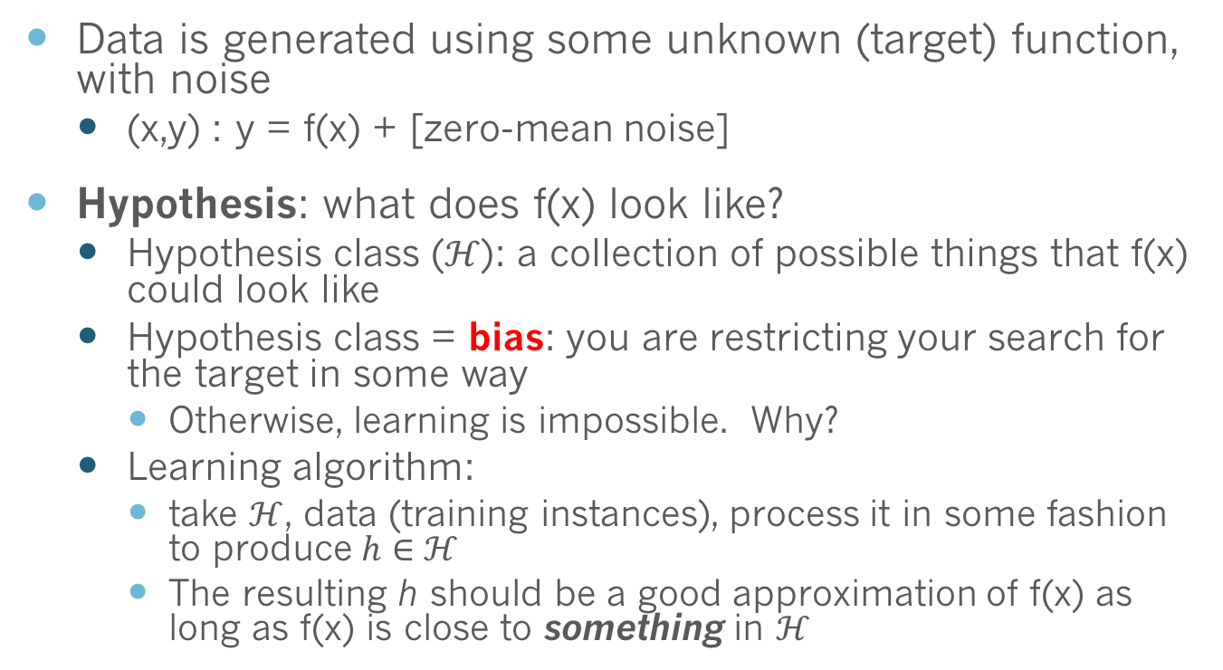
What is learning?
Data is generated using some unknown (target) function, with noise
(x,y) : y = f(x) + [zero-mean noise]
Hypothesis: what does f(x) look like?
Hypothesis class ($ℋ$): a collection of possible things that f(x) could look like
Hypothesis class = bias: you are restricting your search for the target in some way
Otherwise, learning is impossible. Why?
Learning algorithm:
take $ℋ$, data (training instances), process it in some fashion to produce $h∈ℋ$
The resulting h should be a good approximation of f(x) as long as f(x) is close to something in $ℋ$

Slide 27
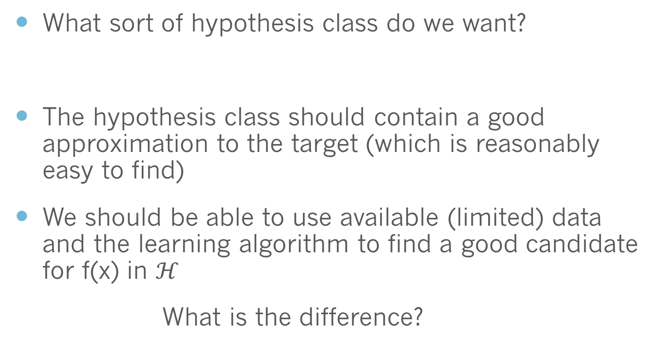
Choosing Hypothesis Class
What sort of hypothesis class do we want?
The hypothesis class should contain a good approximation to the target (which is reasonably easy to find)
We should be able to use available (limited) data and the learning algorithm to find a good candidate for f(x) in $ℋ$
What is the difference?

Slide 28
Hypothesis Tradeoff
Rich hypothesis class
Over-fitting; high variance (not enough information in limited data to nail down exactly the right function!)
Why is it high variance?
Simple, easy to search hypothesis class
Under-fitting; low variance
Realization: we are unlikely to ever find the hypothesis that exactly explains the data
Simplifying assumptions help find a reasonable hypothesis
Select hypothesis class based on knowledge of data
Notes:
Show polynomial line fitting example

Slide 29
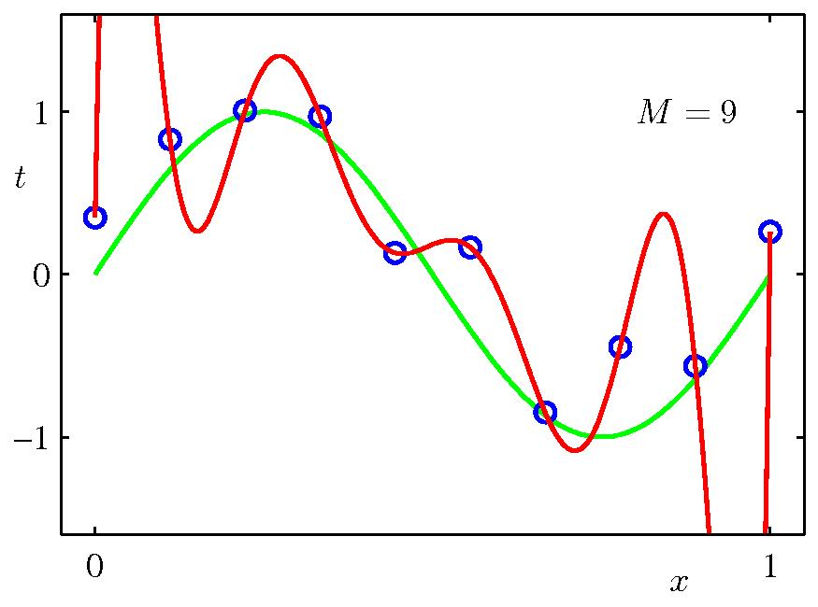
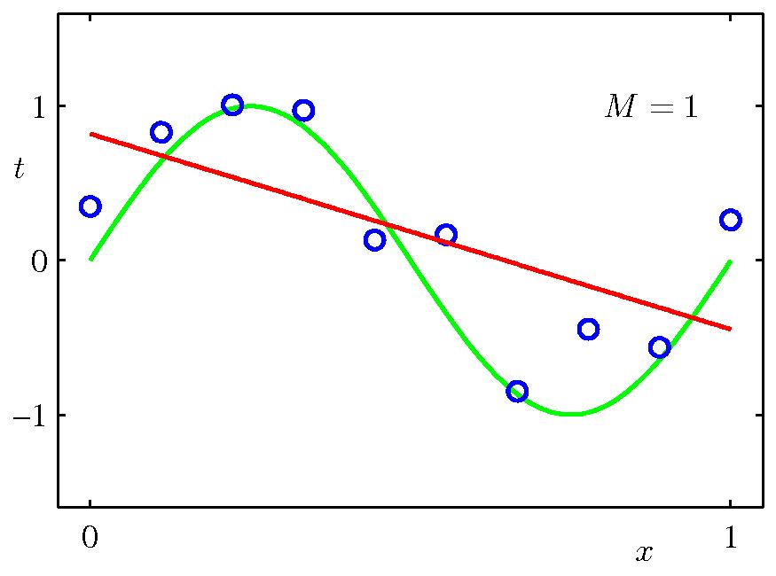
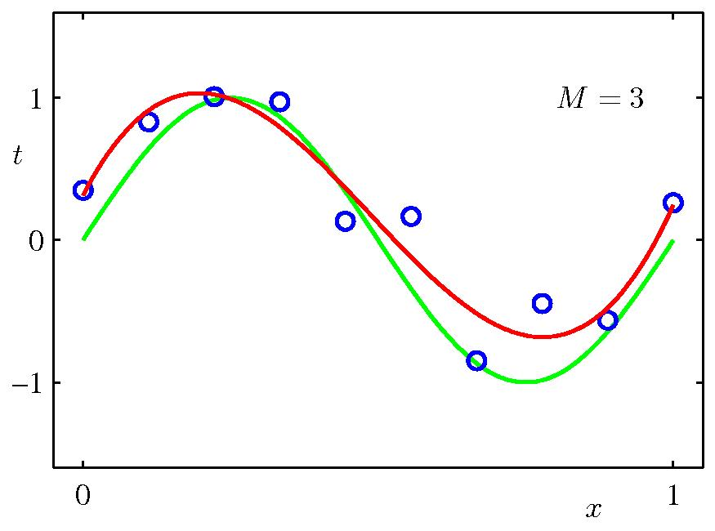
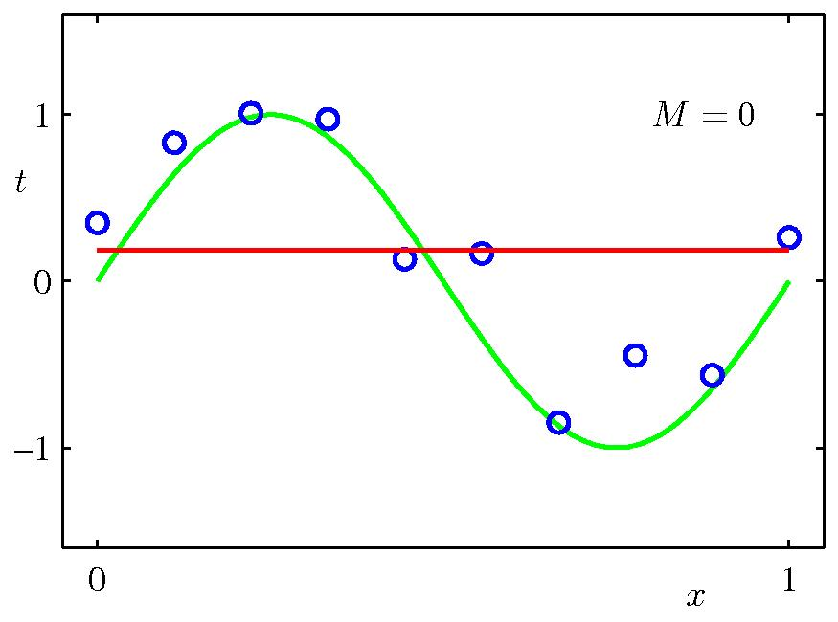
Under/Over Fitting

Slide 30
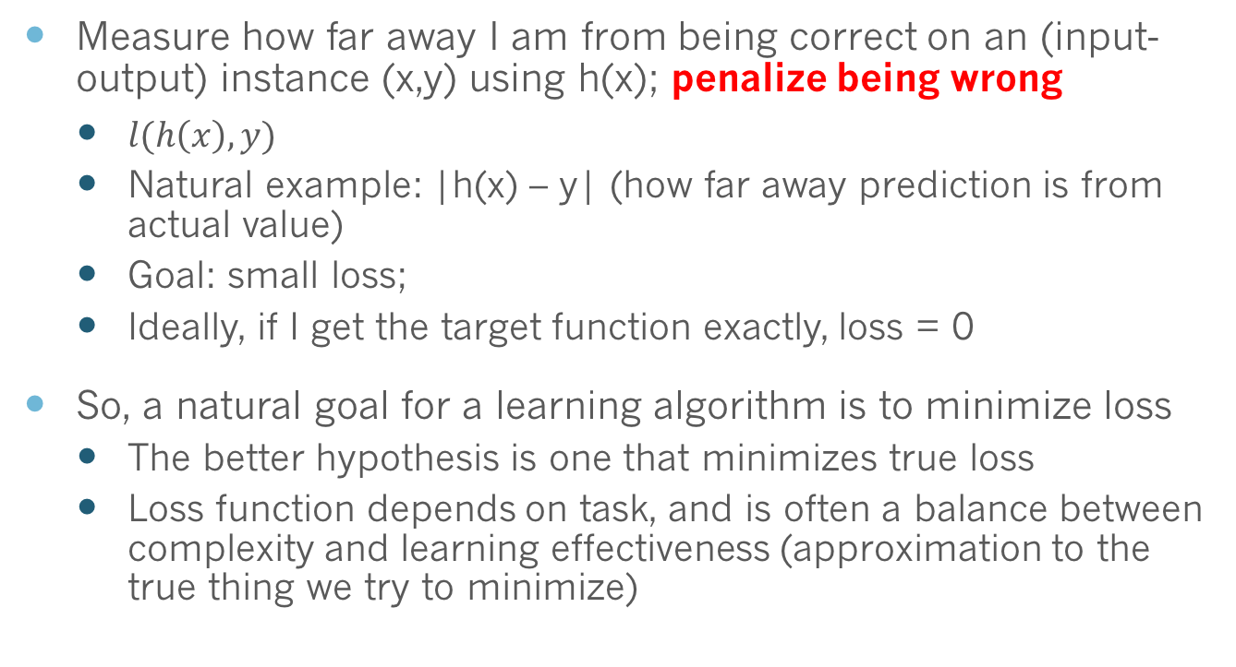
Loss Functions
Measure how far away I am from being correct on an (input-output) instance (x,y) using h(x); penalize being wrong
$l(h\left(x\right),y)$
Natural example: |h(x) – y| (how far away prediction is from actual value)
Goal: small loss;
Ideally, if I get the target function exactly, loss = 0
So, a natural goal for a learning algorithm is to minimize loss
The better hypothesis is one that minimizes true loss
Loss function depends on task, and is often a balance between complexity and learning effectiveness (approximation to the true thing we try to minimize)

Slide 31
What is Learning?
Select a hypothesis from the hypothesis class
Model parameters correspond to hypotheses
Learn parameters of model based on training data
How do we write learning algorithms?
Theory: Objective driven
Write an objective that you want to minimize
Develop a procedure to minimize the objective
This is called the learning algorithm
Linear regression, SVM are good examples
Empirical: intuition driven
Many algorithms based on intuition and heuristics
Post hoc analysis of objective
Decision trees are a good example
Notes:
Many algorithms will have objectives. This is where math comes in.
We go back and forth between these

Slide 32
Output
Errors
Evaluation

Slide 33
What Causes Error?
Noise
An example has an incorrect or inconsistent label
Our data representation fails to encode necessary information
Not much we can do about this
Model error
Hypothesis class is deficient: model bias
Parameter estimation error
The model parameters are wrong: model variance

Slide 34
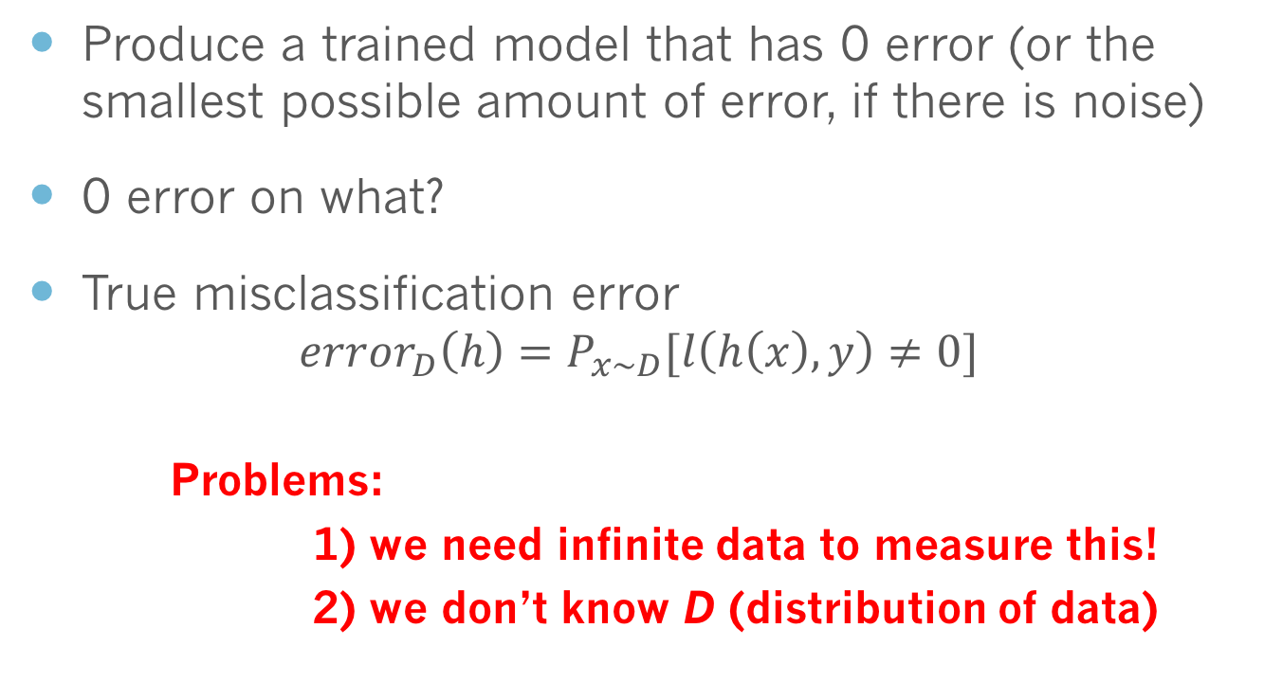
Goal of Learning
Produce a trained model that has 0 error (or the smallest possible amount of error, if there is noise)
0 error on what?
True misclassification error
$$error_{D}\left(h\right)=P_{x∼D}[l\left(h\left(x\right),y\right)≠0]$$
Problems:
1) we need infinite data to measure this!
2) we don’t know D (distribution of data)

Slide 35
Goal of Learning
If we can’t measure true error, how do we judge learning success?
Should an algorithm maximize performance on observed data?
Proposal: evaluate error on the training data
Motivation: training data is (assumed to be) sampled from the true underlying distribution D; the more training data there is, the more information we have about D
Is this a good idea?

Slide 36
Evaluating Error
Very bad idea:
Can store the data, so that we can trivially get zero error for any instance already seen!
Recall: machine learning cares about the future
How well will the system do once deployed?
If we simply store the data, we can’t say anything useful about instances we haven’t seen before!
What we want is a model that predicts well
But how do we evaluate predictive accuracy?

Slide 37
Generalization
Generalization
The ability of an algorithm to generalize knowledge learned from observed data to new data
Simple example: memory based classifier
Binary classification
Train: remember each example
Test: if we have seen an example before, report label
Otherwise, guess randomly
Train error: 0% Test error: 50%
This is called over-fitting

Slide 38
Bias vs. Variance
How do we achieve good generalization?
Tradeoff bias and variance
Bias- rigid predictions (vary little with data)
Variance- diversity of predictions (vary a lot depending on data)
Under-fit observed data
Favors bias- large changes to input have same output
Over-fit observed data
Favors variance- small changes to input can dramatically change output
Tradeoff key to generalization to new data
Notes:
Return to polynomial line fitting example

Slide 39
Under/Over Fitting
Notes:
Bias- underfitting
Variance-overfitting

Slide 40
Evaluating Error: The Right Way
Collect two sets of data
Training data- use for training algorithm
Test data- only use for evaluation
Only good if you’ve never seen it before, not if you continuously tune on it
How do we balance bias/variance?
Tune parameters on development/validation data

Slide 41
Typical Learning Curves
Notes:
Also a function of learning time
Tradeoff is the max on test curve

Slide 42
Train/Dev/Test Challenges
Test data may not be representative of true distribution
Too little or biased data
It’s hard to collect a lot of data
How much should we use?
More training data yields better models
More training data- better model
More test data- better evaluation

Slide 43
Cross Validation
Create many train/test splits
Randomly sample train and test data splits
Divide data into folds, use each fold for testing once
10-fold cross validation
Problems
How many splits are enough
We never use all of the training data
Leave one out CV
N-fold CV, N=data size
Use N-1 training examples
No random sampling of data
Problem: impossible for large datasets

Slide 44
Sampling with Replacement
Aka “The Bootstap”
Create random datasets
Sample n training examples with replacement
Data not appearing in sample is test data
On average: train 63.2% and test 36.8% of data
Notes:
Algorithm that does normal training but memorizes the training data as well

Slide 45
Comparing Two Algorithms
Statistical test to differentiate two samples
Null hypothesis
Do these two algorithms differ in performance
Significant difference if 5% or less chance of them not being different
Test specific to setting

Slide 46
Evaluation Metric
It seems simple
Classification: accuracy
Regression: squared error
Not so! Evaluation metrics are often debated

Slide 47
Spam Classification
Two spam systems classify 100 emails
System 1
2 emails mistakenly labeled spam
18 emails mistakenly labeled not-spam
System 2
10 emails mistakenly labeled spam
0 emails mistakenly labeled not-spam
Which is better?

Slide 48
Information Retrieval (IR)
Two search engines give ranked sets of documents
Which is better?
Retrieving 10, of which 4 are actually relevant
Retrieving 40, of which 8 are actually relevant

Slide 49
Precision/Recall
Precision- the quality of the selected example
Correctly selected documents / number of selected documents
Measures false positives
Recall- the quantity of correct documents selected
Correctly selected documents / total number of relevant documents
Measures false negatives
F-measure- harmonic mean of precision and recall
2 * recall * precision / (recall+precision)
Notes:
Also called sensitivity and specificity

Slide 50
Overfit it Thriller
https://www.youtube.com/watch?v=DQWI1kvmwRg

